Slide 1
Regularization

Slide 2
References
An Introduction to Statistical Learning, with Applications in R (2013), by G. James, D. Witten, T. Hastie, and R. Tibshirani.
The Elements of Statistical Learning (2009), by T. Hastie, R. Tibshirani, and J. Friedman.
Learning from Data: A Short Course (2012), by Y. Abu-Mostafa, M. Magdon-Ismail, and H. Lin.
Machine Learning: A Probabilistic Perspective (2012), by K. Murphy.

Slide 3
Shrinkage (Regularization) Methods
The subset selection methods use OLS to fit a linear model that contains a subset of the predictors.
As an alternative, we can fit a model containing all p predictors using a technique that constrains or regularizes the coefficient estimates (i.e. shrinks the coefficient estimates towards zero).
It may not be immediately obvious why such a constraint should improve the fit, but it turns out that shrinking the coefficient estimates can significantly reduce their variance.

Slide 4
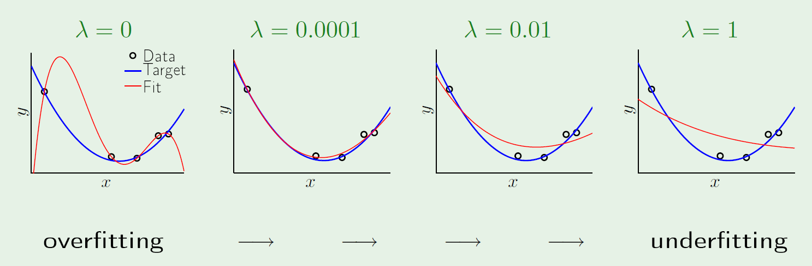
Shrinkage (Regularization) Methods (cont.)
Regularization is our first weapon to combat overfitting.
It constrains the machine learning algorithm to improve out-of-sample error, especially when noise is present.
Look at what a little regularization can do:

Slide 5
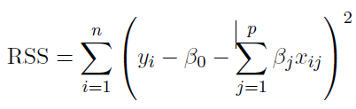
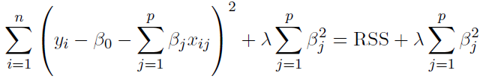
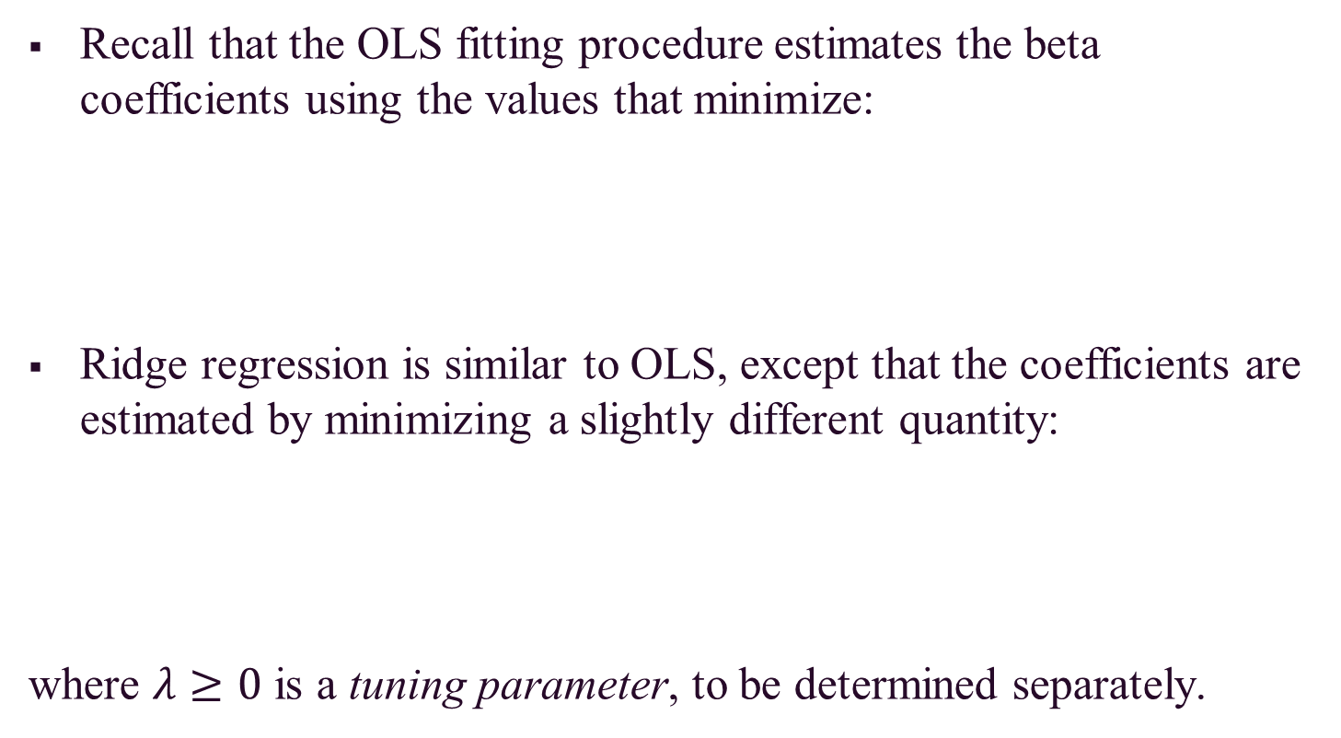
Ridge Regression
Recall that the OLS fitting procedure estimates the beta coefficients using the values that minimize:
Ridge regression is similar to OLS, except that the coefficients are estimated by minimizing a slightly different quantity:
where $λ≥0$ is a tuning parameter, to be determined separately.

Slide 6
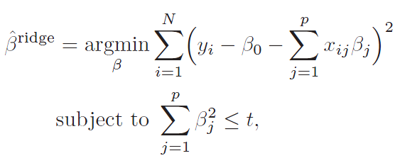

Ridge Regression (cont.)
Note that $λ≥0$ is a complexity parameter that controls the amount of shrinkage.
The idea of penalizing by the sum-of-squares of the parameters is also used in neural networks, where it is known as weight decay.
An equivalent way to write the ridge problem is:

Slide 7
Ridge Regression (cont.)
The effect of this equation is to add a shrinkage penalty of the form
where the tuning parameter λ is a positive value.
This has the effect of shrinking the estimated beta coefficients towards zero. It turns out that such a constraint should improve the fit, because shrinking the coefficients can significantly reduce their variance.
Note that when λ = 0, the penalty term as no effect, and ridge regression will procedure the OLS estimates. Thus, selecting a good value for λ is critical (can use cross-validation for this).

Slide 8
Ridge Regression (cont.)
As λ increases, the standardized ridge regression coefficients shrinks towards zero.
Thus, when λ is extremely large, then all of the ridge coefficient estimates are basically zero; this corresponds to the null model that contains no predictors.

Slide 9
Ridge Regression (cont.)
The penalty term makes the ridge regression estimates biased but can also substantially reduce variance
As a result, there is a bias/variance trade-off.

Slide 10
The Lasso (Least Absolute Shrinkage and Selection Operator)
One significant problem of ridge regression is that the penalty term will never force any of the coefficients to be exactly zero.
Thus, the final model will include all p predictors, which creates a challenge in model interpretation
A more modern machine learning alternative is the lasso.
The lasso works in a similar way to ridge regression, except it uses a different penalty term that shrinks some of the coefficients exactly to zero.

Slide 11
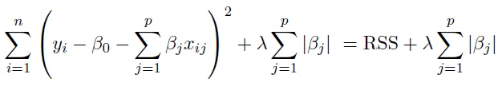
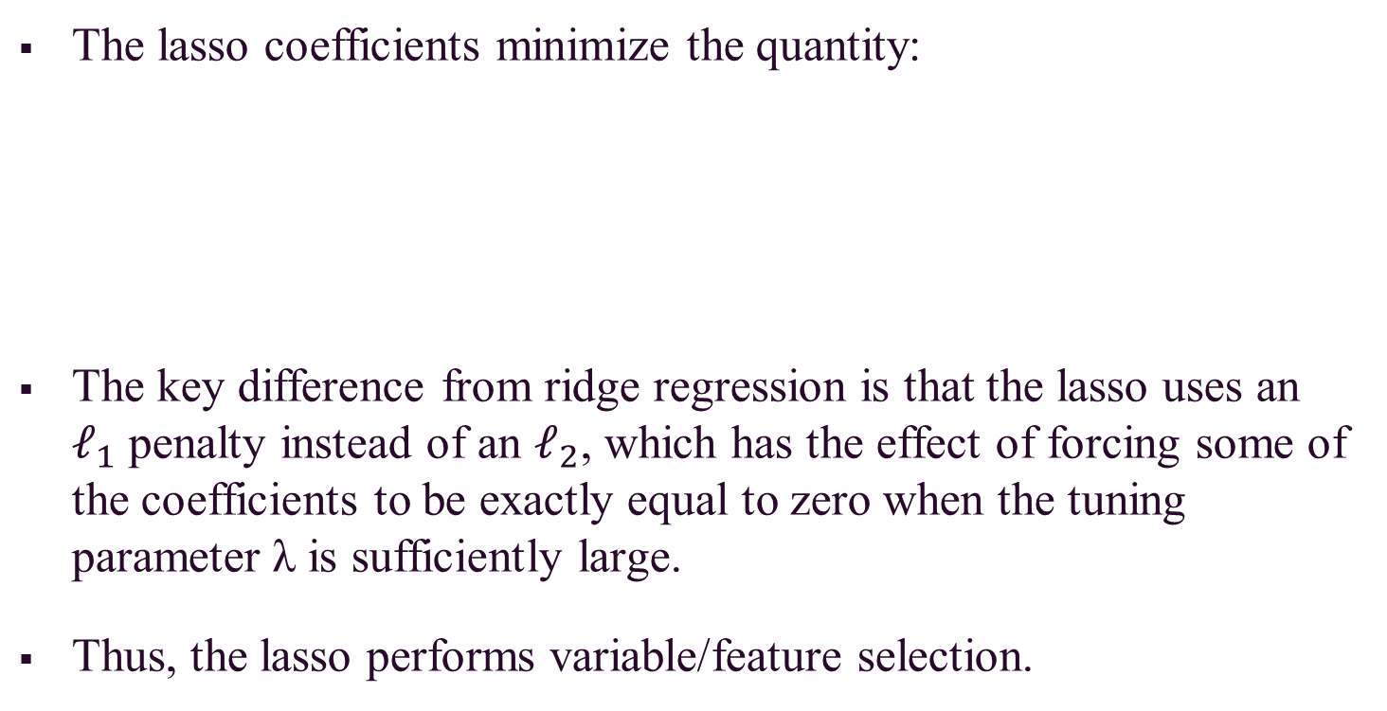
The Lasso (cont.)
The lasso coefficients minimize the quantity:
The key difference from ridge regression is that the lasso uses an $ℓ_{1}$ penalty instead of an $ℓ_{2}$, which has the effect of forcing some of the coefficients to be exactly equal to zero when the tuning parameter λ is sufficiently large.
Thus, the lasso performs variable/feature selection.

Slide 12
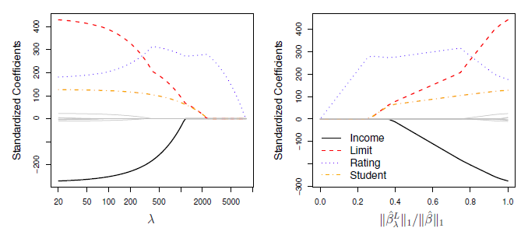
The Lasso (cont.)
When λ = 0, then the lasso simply gives the OLS fit.
When λ becomes sufficiently large, the lasso gives the null model in which all coefficient estimates equal zero.

Slide 13
Lasso vs. Ridge Regression
The lasso has a major advantage over ridge regression, in that it produces simpler and more interpretable models that involved only a subset of predictors.
The lasso leads to qualitatively similar behavior to ridge regression, in that as λ increases, the variance decreases and the bias increases.
The lasso can generate more accurate predictions compared to ridge regression.
Cross-validation can be used in order to determine which approach is better on a particular data set.

Slide 14
Selecting the Tuning Parameter λ
As for subset selection, for ridge regression and lasso we require a method to determine which of the models under consideration in best; thus, we required a method selecting a value for the tuning parameter λ or equivalently, the value of the constraint s.
Select a grid of potential values; use cross-validation to estimate the error rate on test data (for each value of λ) and select the value that gives the smallest error rate.
Finally, the model is re-fit using all of the variable observations and the selected value of the tuning parameter λ.

